Slide 1

Smart Traffic Lights: Enhancing Road Safety with Intelligent Control Systems
2023-IMT-052 : Niharika Saxena
2023-IMT-055 : Paridhi Jain
2023-IMT-058 : Pranjali Goyal
Notes:
NOTE:
To change the image on this slide, select the picture and delete it. Then click the Pictures icon in the placeholder to insert your own image.

Slide 2
Introduction
The management of traffic is a crucial element in ensuring the safety, efficiency, and sustainability of our cities, especially in the constantly evolving urban transportation landscape.
The traditional traffic management systems that rely on fixed schedules and lack the ability to adapt to real-time traffic conditions have limitations in addressing the ever-growing traffic congestion problem. However, the introduction of smart traffic lights, also known as intelligent traffic systems, has revolutionized traffic management by integrating cutting-edge technologies such as sensors, connectivity, and predictive algorithms.
These smart traffic lights have the ability to optimize traffic flow in an intelligent and adaptive manner, offering a holistic solution to manage traffic in our cities. In this report, we will explore the world of smart traffic lights, looking into their various applications for both vehicles and pedestrians, and how they are transforming the way we manage traffic in our cities.

Slide 3
Overview
Smart traffic lights have emerged as a game-changer in the world of traffic management. These innovative devices represent a paradigm shift from the static, time-based systems that were used in the past. By using advanced technologies such as sensors, buzzers, and video systems, these intelligent traffic lights can dynamically adjust traffic signals to the ever-changing traffic conditions.
The benefits of smart traffic lights are numerous. Firstly, they enhance safety on the roads by reducing the likelihood of accidents caused by sudden stops or unexpected changes in traffic flow. Secondly, they reduce traffic congestion by optimizing the flow of traffic through intersections. Thirdly, they improve overall traffic management by providing real-time data on traffic conditions, which can be used to adjust traffic patterns and optimize traffic flow.
Another major benefit of smart traffic lights is their ability to reduce emissions and improve air quality. By reducing the amount of time vehicles spend idling at intersections, these devices can help to reduce carbon emissions and improve air quality in urban areas.
Overall, smart traffic lights have the potential to revolutionize the way we manage traffic on our roads. As more cities and municipalities adopt these technologies, we can expect to see safer, more efficient, and more sustainable transportation systems in the years to come.

Slide 4
Motivation
The motivation behind smart traffic lights stems from the need to address several critical challenges:
1. Growing Urbanization: Our cities are expanding, leading to increased traffic density. Conventional traffic lights struggle to handle this surge efficiently.
2. Traffic Disruptions: Accidents, roadworks, and emergencies disrupt traffic flow. Smart lights can adapt to these situations in real time.
3. Environmental Impact: Smart traffic systems use sensors to monitor vehicle flow and allocate more time to the side with heavier traffic. This reduces idle time at intersections and improves fuel efficiency and air quality.

Slide 5
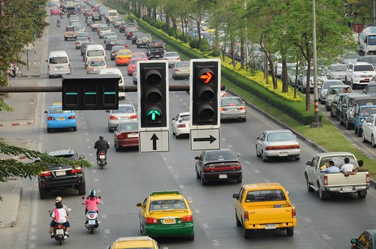
Advancement In Traffic Signals To Reduce Rush
One potential solution for reducing traffic congestion at a crossroads could involve adjusting the duration of the green signal based on the level of traffic rush detected on each side. By using sensors to monitor the flow of vehicles, the traffic lights could be programmed to allocate more time to the side with heavier traffic, allowing for smoother and more efficient movement of vehicles through the intersection.

Slide 6
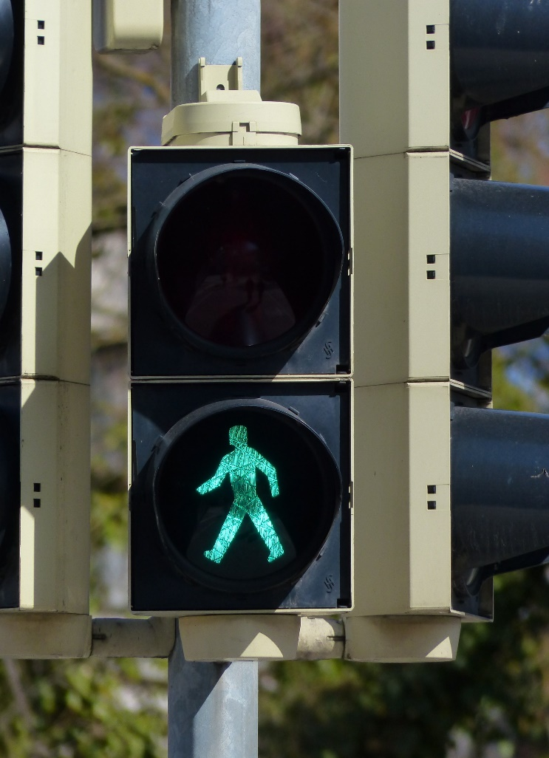
Traffic Light Sensors: New Advancement
In order to improve pedestrian safety, we have decided to incorporate an additional PIR sensor and a buzzer in our traffic light system. This sensor will help detect the presence of pedestrians and adjust the traffic lights accordingly, ensuring that they have enough time to cross the road safely. This is in addition to the digital sensors that are already in place, which help regulate the flow of traffic based on the number of vehicles on the road. By incorporating this PIR sensor, we hope to create a more efficient and safer traffic system for both drivers and pedestrians.

Slide 7
Methodology: Digital Sensors
Digital sensor systems allow transportation authorities to log countless hours of traffic data that can be used for future planning of routes and city projects.
Traffic lights employ a variety of advanced sensors for vehicle detection. These are typically installed near the lights and include infrared sensors, microwave beam emitters, and video cameras.
An active infrared sensor system shoots out a beam of infrared light that stops just where a car might be during a red light. When a vehicle pulls up, the beam is broken and the sensor can detect that the space is occupied. (Emergency vehicles like ambulances and police cars have active sensors that can request a traffic light be changed, usually when their lights or sirens are on.)
They all talk to a server running software designed to identify vehicles and count the number of them at a stop in real-time. The network takes in all this data and then attempts to run the series of lights at maximized efficiency. Long-term analytics are then be used to improve the system further or figure out where roads need to be modified.

Slide 8
Methdology: PIR Sensors
Passive Infrared Sensor (PIR) is a very useful module, used to build many kinds of Security Alarm Systems and Motion Detectors. It is called passive because it receives infrared, not emits. Basically, PIR sensor detects any change in heat, and whenever it detects any change, its output PIN becomes HIGH. They are also referred to as Pyroelectric or IR motion sensors.
Here we should note that every object emits some amount of infrared when heated. Human also emits infrared because of body heat. PIR sensors can detect small amounts of variation in infrared. Whenever an object passes through the sensor range, it produces infrared because of the friction between the air and the object which gets caught by the PIR.

Slide 9
Traffic Light Sensors: PIR Sensors
Thermal imaging pedestrian sensors can be used to control traffic signals or warning lights by detecting pedestrians at the intersection, either on the curbside or on the crosswalk. The pedestrian presence detector will transmit its detection information over contact closures or TCP/IP to the traffic signal controller and will thus allow a more dynamic control of traffic signals in favour of pedestrians or activation of warning lights to make pedestrians more visible in the traffic scene. With dynamic traffic light control and warning sign activation, you can make your intersection or pedestrian crossing safer and at the same time prevent unnecessary delays to both pedestrians and motorists.

Slide 10
Traffic Light Sensors: Advantages
Smart traffic lights monitor incoming traffic and continuously adjust their timing to keep vehicles flowing as smoothly as possible, communicating with other lights along routes and working together to keep logjams from developing.
Thus, we can control the traffic based on density which is an effective way to save time.
We will have to arrange one infrared sensor for each road; these sensors will sense the traffic density on that particular road. All these sensors are interfaced with the microcontroller. Based on these sensors, the controller detects the traffic and controls the traffic system.

Slide 11
Components used
1. Arduino Uno: The Arduino Uno is an open-source microcontroller board based on the Microchip ATmega328P microcontroller (MCU). It serves as a versatile platform for various electronic projects.
2. PIR Sensor: This sensor collects data on the pedestrian movement.
3. Buzzer: When PIR sensor senses the pedestrians, the buzzer makes a sound and the vehicle light turns red for the safety of the pedestrian.
4. IR Sensors: These four sensors at each intersection collects data on vehicle movement. For our project, we’ll focus on densitybased sensors that measure traffic volume at intersections.
5. Resistors: Twelve resistors each of 47Ω used to connect each traffic LED light to the electrical circuit.
6. LED Lights: 12 LED lights, three each (red, yellow, green) on each of the four intersections.

Slide 12
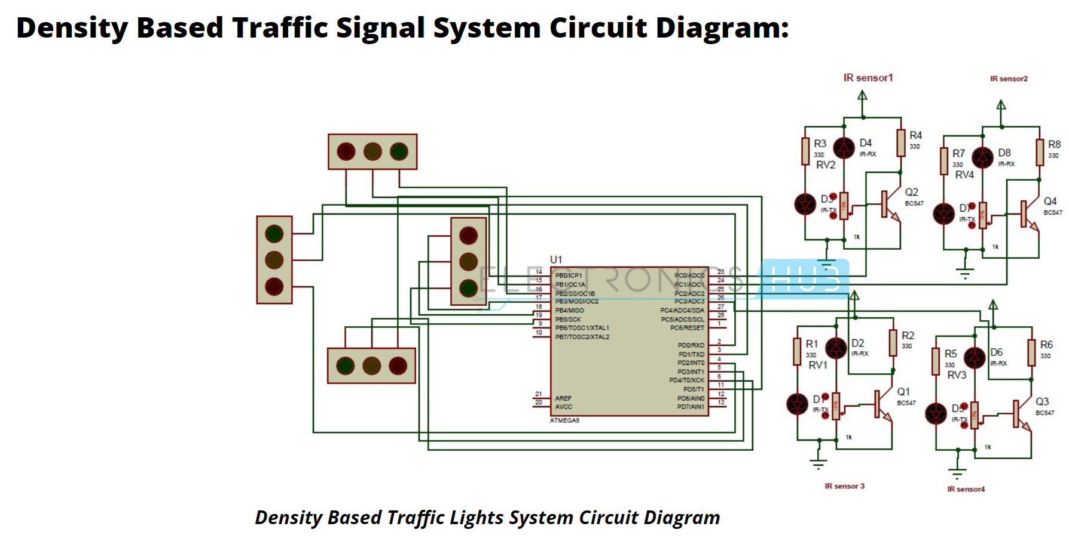
Traffic Light Sensors: Digital Sensors
Circuit Components:
ATmega8 controller
PCB board
IR sensors -4
LED’s-12
12v Battery or adaptor
Serial cable
Connecting wires

Slide 13
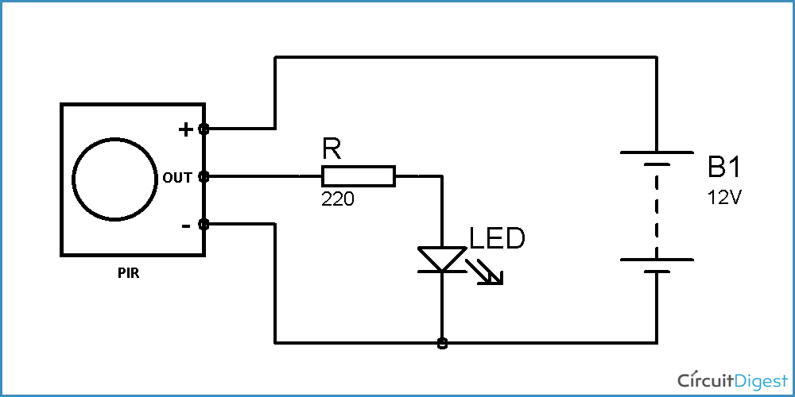
Traffic Light Sensors: PIR Sensors
Circuit Components:
PIR Sensor (we used HC-SR501)
Resistor 220Ω (any resistor < 1kΩ)
LED
Battery (5-9V)

Slide 14
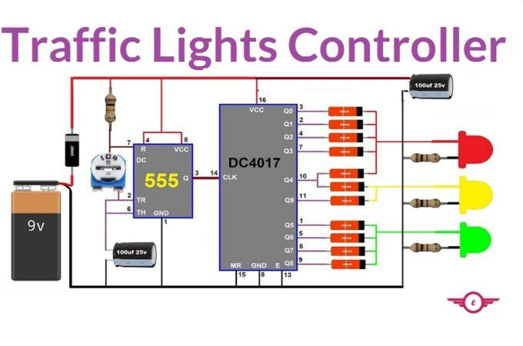
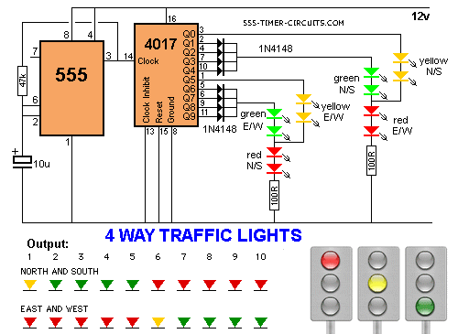
Advanced Traffic Signals: Model

Slide 15
Future Scope
1. Integration with Autonomous Vehicles
As self-driving cars become more prevalent, smart traffic lights can communicate directly with these vehicles. Imagine a scenario where traffic lights adjust their timing based on real-time data from autonomous cars. This synchronization could significantly enhance traffic flow and safety.
2. Predictive Analytics
By anticipating congestion, accidents, or special events, they can proactively optimize signal timings.
3. Emergency Response Optimization
Smart traffic lights can prioritize emergency vehicles during critical situations by dynamically clearing intersections and providing green lights.
4. Environmental Considerations
Integrating air quality sensors into traffic lights allows them to reduce emissions. For instance, during high pollution levels, the system could favor public transportation or electric vehicles.

Slide 16
Future Scope (contd.)
5. Interconnected City Infrastructure
Integrating traffic lights with other urban systems (such as public transportation, parking, and street lighting) creates a holistic smart city ecosystem.
6. Behavioral Insights
Analyzing driver behavior at intersections can provide valuable insights. Are drivers running red lights? Are pedestrians crossing safely? Smart traffic lights can help address these issues.
7. Adaptive Learning
Continual learning from real-world scenarios allows smart traffic lights to adapt and improve over time. Machine learning models can fine-tune signal timings based on actual performance.
8. Collaboration Across Municipalities
Standardizing smart traffic light protocols enables seamless travel across cities. Imagine driving from one city to another without encountering outdated or incompatible signal systems.
In summary, the future of smart traffic lights is dynamic, data-driven, and interconnected. As technology advances, these intelligent signals will continue to play a pivotal role in shaping our urban mobility landscape.

Slide 17
Conclusion
Smart traffic lights provide a wide range of benefits, including increased safety, reduced traffic congestion, improved travel times, and enhanced sustainability. By using real-time data to monitor traffic conditions, these systems can adjust traffic signal timings to ensure that traffic flows smoothly and efficiently.
For instance, during peak hours, smart traffic lights can prioritize the flow of vehicles on major roads, reducing congestion and minimizing travel times. Another significant benefit of smart traffic lights is that they can be used to improve pedestrian safety.
By detecting the presence of pedestrians at crosswalks, these systems can adjust signal timings to give them more time to cross the road safely. This feature is particularly useful in busy urban areas where pedestrians and vehicles share the same space.

Slide 18
Thank you ☺
Niharika Saxena 2023-IMT-052
Paridhi Jain 2023-IMT-055
Pranjali Goyal 2023-IMT-058

